Slide 1
Presentation 4
Patching - Anna, Kota, Jake, Hannah, John, and Ryan

Slide 2
Objectives
Test the patching code and identify any issues
Work with the issue of contour within contour, i.e., epithelium within epithelium
Decide whether to use Ryan or Sharon's variation
Incorporating Thinkers’ epithelium width calculation into Ryan’s codebase
Determine what hyperparameter values will be appropriate given that our priority is covering the epithelium and that % overlap and amount of background in patch are not that important
Solve contour within contour issue

Slide 3
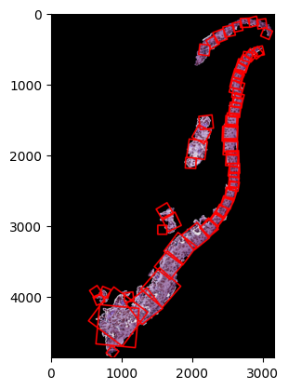
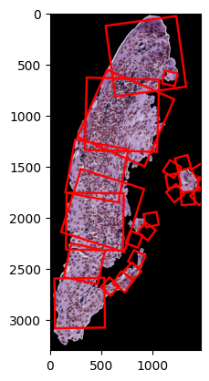
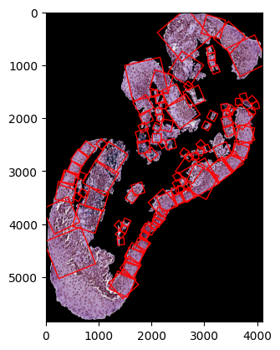
Testing Ryan’s code on new slices
h2114161 h&e_ROI_1
h2114162 h&e_ROI_1
h2114163 h&e_ROI_1

Slide 4
First Issue Found
Normal vector is sometimes drawn outward of the cell instead of inward
Reason: cv2.findContours() calculates outer contours counter-clockwise and inner contours clockwise. This resulted in inconsistent normal orientations when small islands of epithelium exist.
Solution: Ensure all normals point inward by calculating the contour's centroid, checking the direction of the normal, and flipping it if it's wrong
Updated code here, results on the next slide
h2114162 h&e_ROI_1
h2114161 h&e_ROI_1
h2114162 h&e_ROI_1
h2114163 h&e_ROI_1
h2114163 h&e_ROI_1

Slide 5
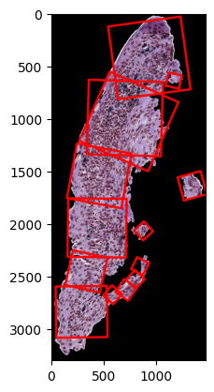
First Issue Found
Coverage: 92.33%
Percent of mask as blank pixels: 24.02%
Score: 89.06%
Coverage: 93.55%
Percent of mask as blank pixels: 17.05%
Score: 91.43%
h2114162 h&e_ROI_1
h2114162 h&e_ROI_1
h2114163 h&e_ROI_1

Slide 6
Second Issue Found
Large section of epithelium is unpatched
Reason: if length>=750 or length<64 constraint in the code to avoid badly sized squares
Temporary Solution: Increase this allowance
Better Solution: Add these parameters into a grid search or optimize them based on epithelium width
h2114163 h&e_ROI_1
h2114161 h&e_ROI_1
h2114162 h&e_ROI_1
h2114163 h&e_ROI_1

Slide 7
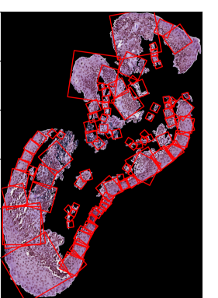
Second Issue Found
Coverage: 74.68%
Percent of mask as blank pixels: 17.98%
Score: 76.15%
Coverage: 85.37%
Percent of mask as blank pixels: 17.46%
Score: 84.80%
h2114163 h&e_ROI_1
h2114163 h&e_ROI_1
h2114161 h&e_ROI_1
h2114162 h&e_ROI_1
h2114163 h&e_ROI_1

Slide 8
Incorporating Thinkers’ epithelium width calculation
Benefits of Coders: no random point generation — every patch is generated along the tangent of the outer contour
Benefits of Thinkers: no iterative patch generation — every patch is generated with epithelium width as size
What if we calculate width of epithelium on the normal line perpendicular to the tangent of the outer contour?
COMBINED: Non-random, non-iterative patching algorithm
Github Link

Slide 9
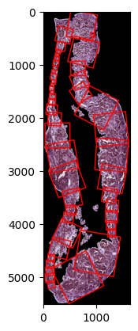
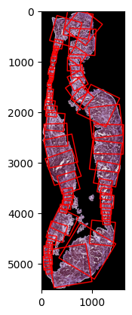

Epithelium width results
Increase parameter overlap_thresh from 0.2 → 0.4

Slide 10
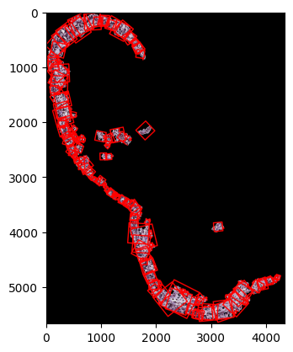
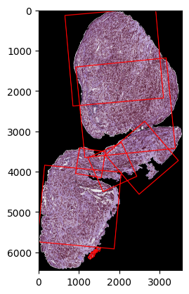


Testing on other patches

Slide 11
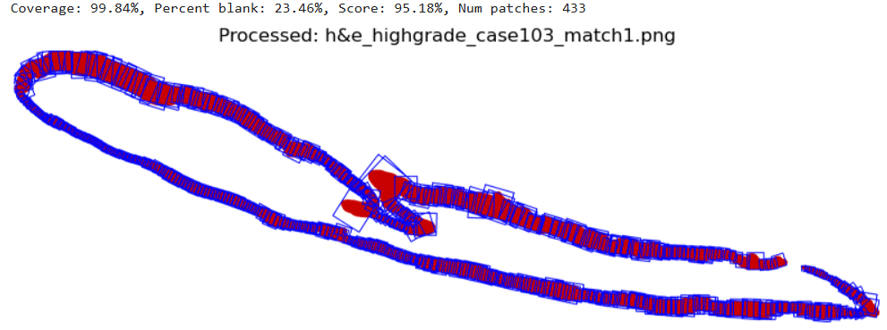
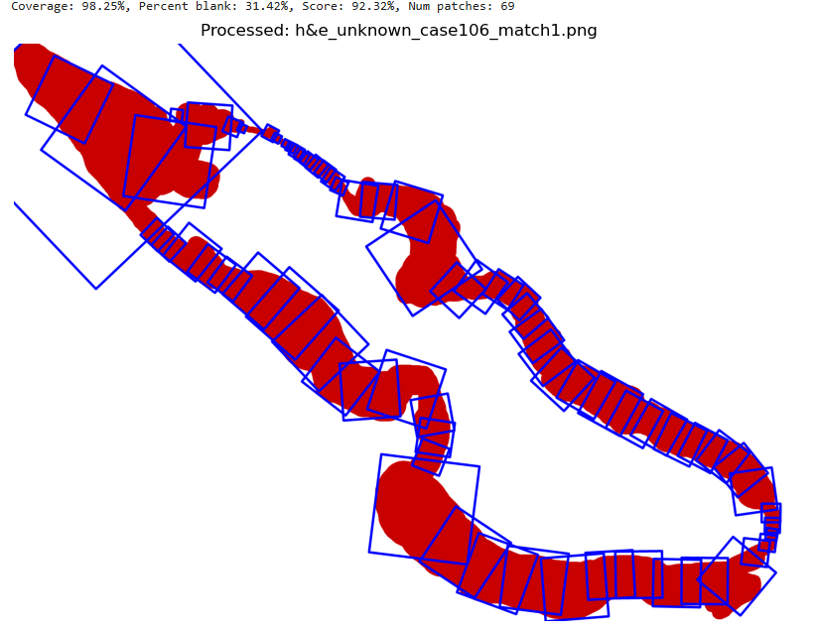
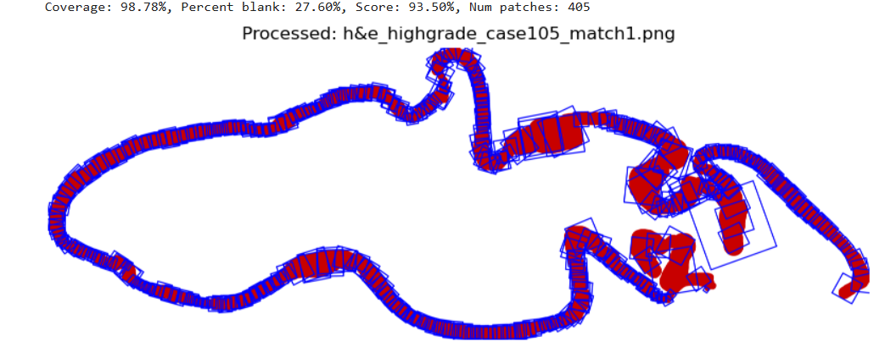
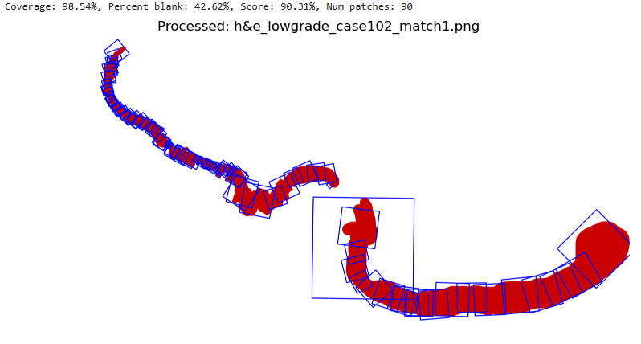
Testing on other patches

Slide 12
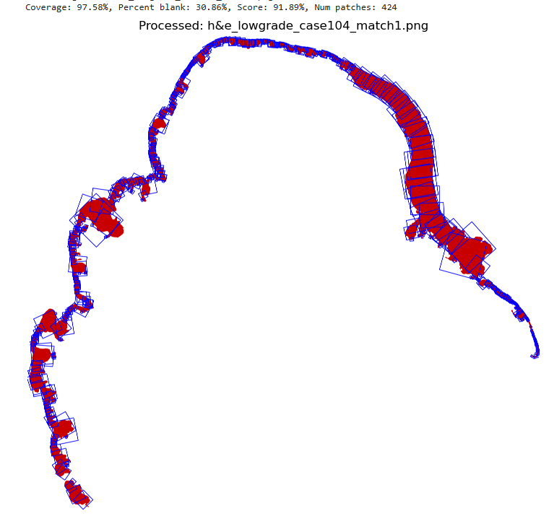
Testing on other patches

Slide 13
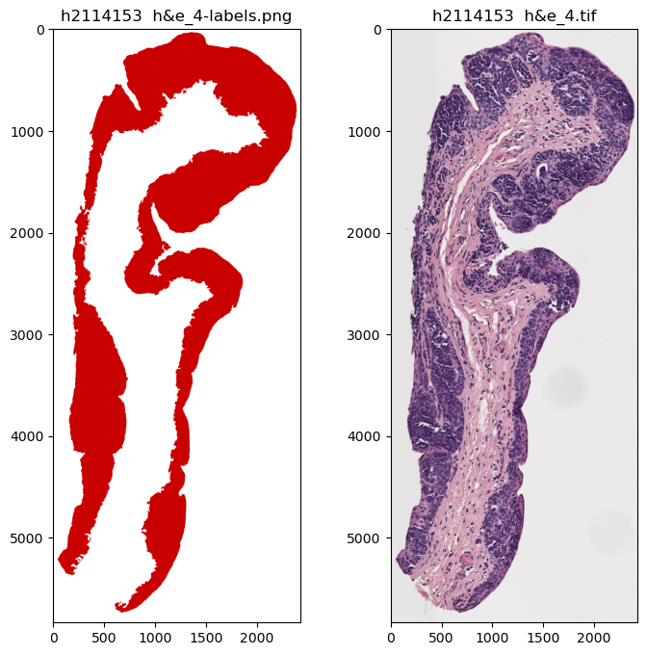
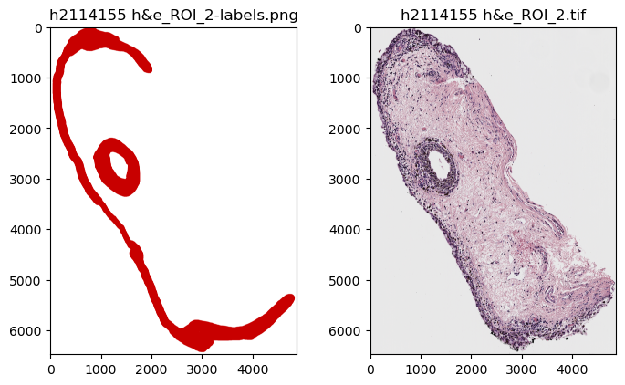
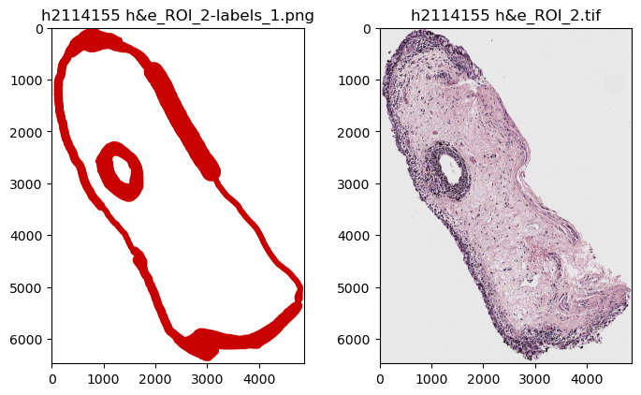
Further Discussion on OpenCV’s findContours()

Slide 14
Process of Using Function
Convert annotated epithelium image to grayscale
Convert that image to black & white
cv.findContours(black & white image, contour retrieval mode, contour approximation)
Retrieval mode specifies which contours are returned
Approximation indicates whether every point on the contour is returned or if it is approximated with straight lines
Because of how the retrieval modes function, certain epithelium shapes will be handled differently
Makes “breaking apart” each epithelium object in the slice more complex

Slide 15
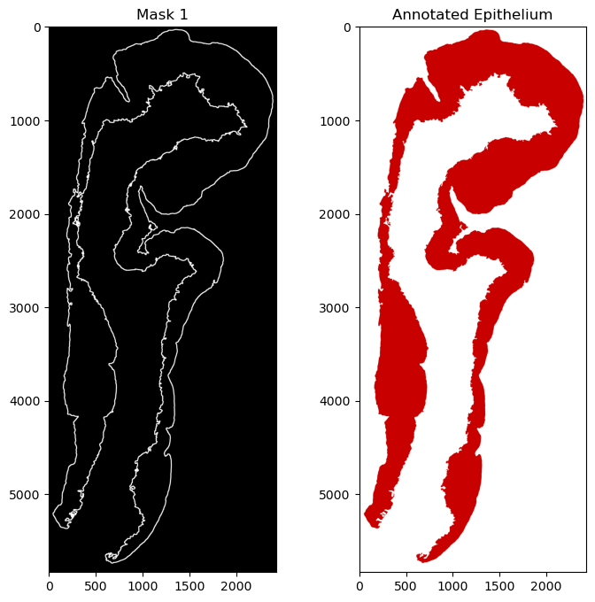
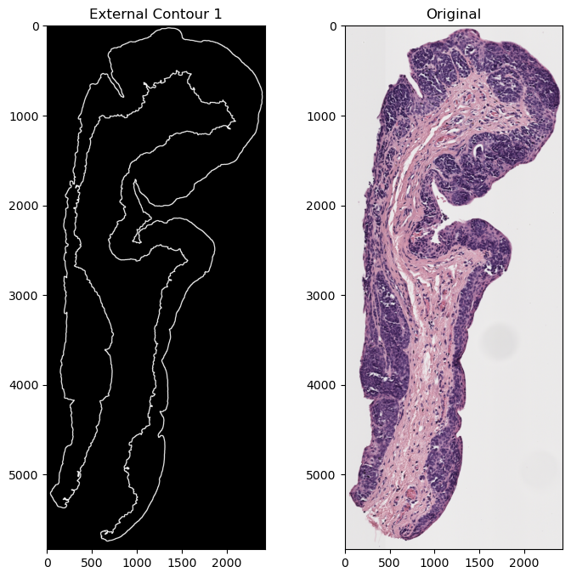
Example 1 (Ideal Case)

Slide 16
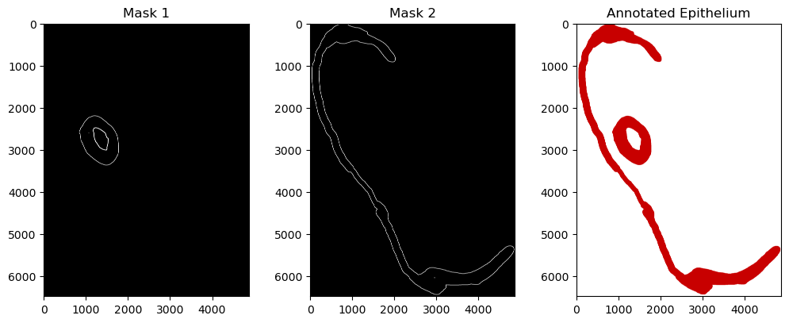
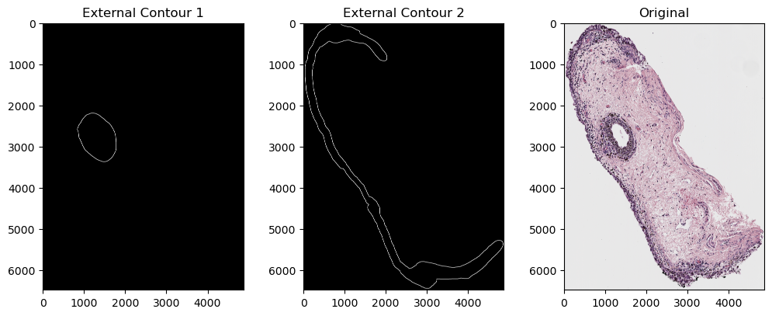
Example 2
We see two objects in annotation
The computer sees 3, but with some help, can see 2
Both objects in annotation are “children” of the top-level image border
Donut-hole is a “child” of the larger circle
Include “children” with “parent” (if “children” exist), but not “grandchildren”/”grandparents”

Slide 17
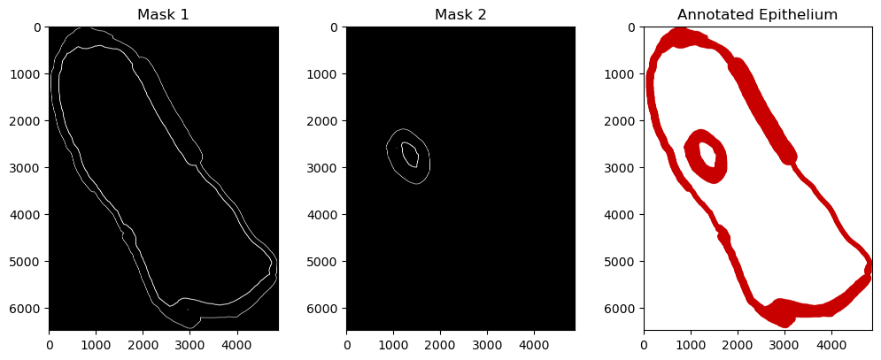
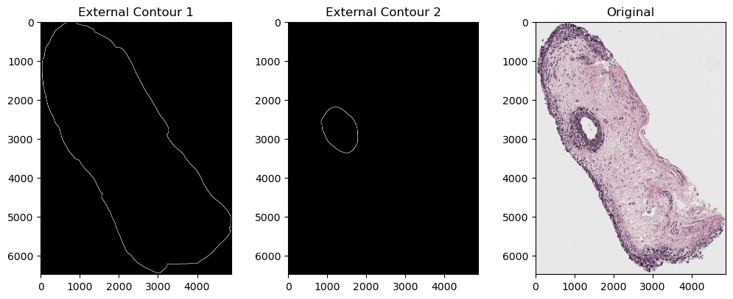
Example 3
Modified previous example to pretend outer epithelium connects
Once again, we see two objects in original annotation
The computer sees 4
Inner epithelium borders are seen as separate from outer
Outermost epithelium edge technically has a “child,” “grandchild” and “great-grandchild”

Slide 18
Conclusions
Have methodology to handle these contour-in-contour cases
Possibly can alter Ryan’s algorithm to always work with outer and inner edges of epithelium
Can test whether there is any difference in coverage
If there isn’t, just focusing on the outer edge like it currently does is more efficient and preferable

Slide 19
Comparing Corner Calculation Approaches
Sharon:
Iteratively evaluate if at least one point on opposite sides are outside of epithelium
Creates more squares
Squares may not cover width of epithelium when convex
Squares can be less aligned with cell
Ryan:
Iteratively increase width along the normal line until outside of epithelium
Creates fewer squares
May leave larger section vacant/sparse
May create very large squares

Slide 20
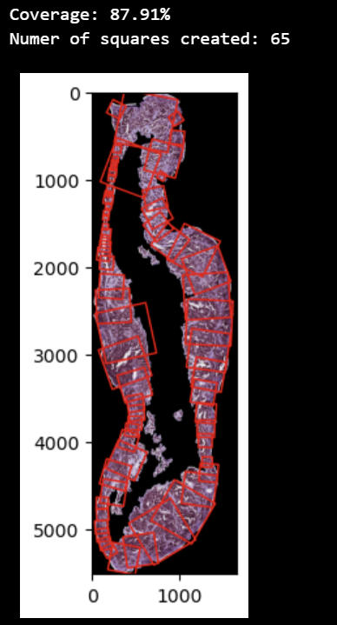
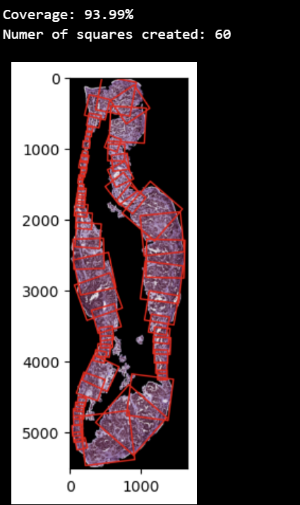
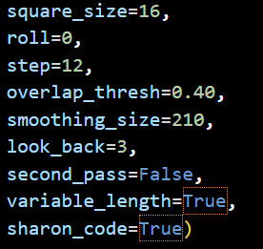
Sharon
Ryan

Slide 21
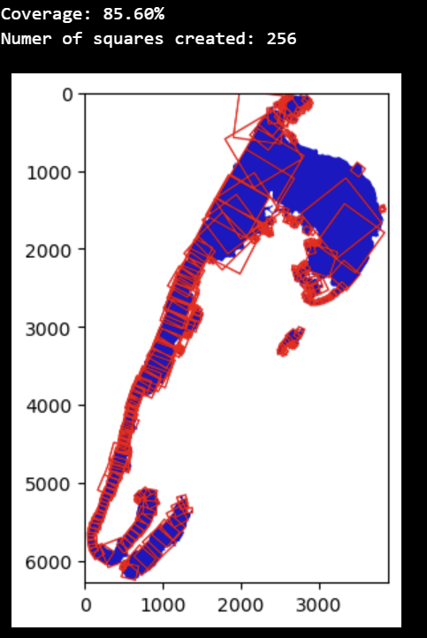
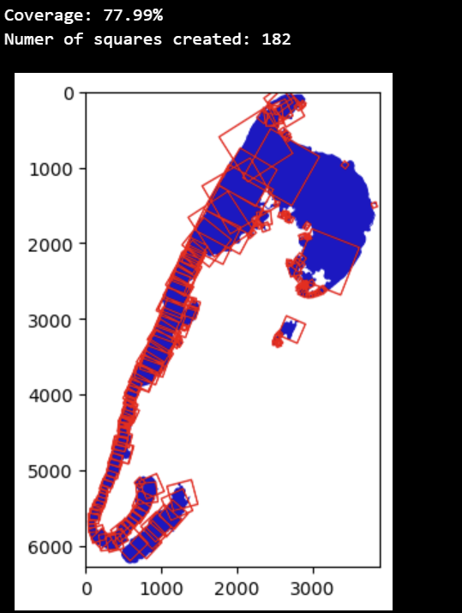
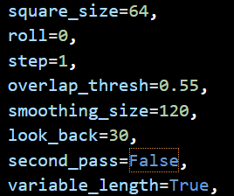
Sharon
Ryan

Slide 22
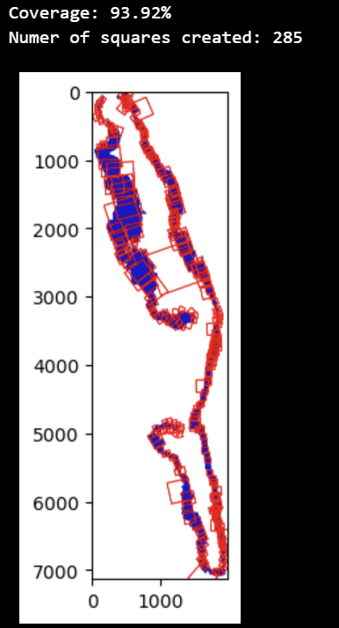
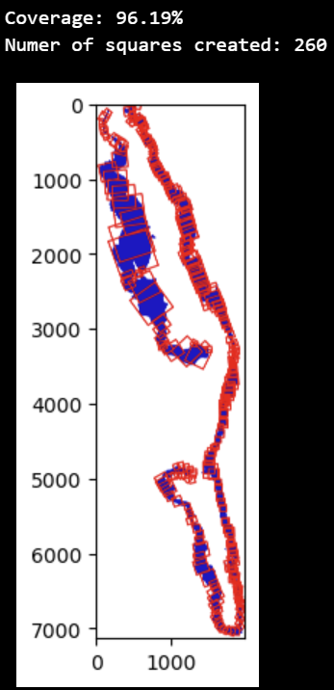
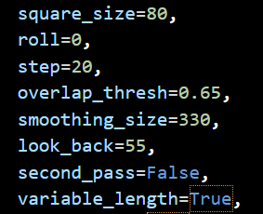
Sharon
Ryan

Slide 23
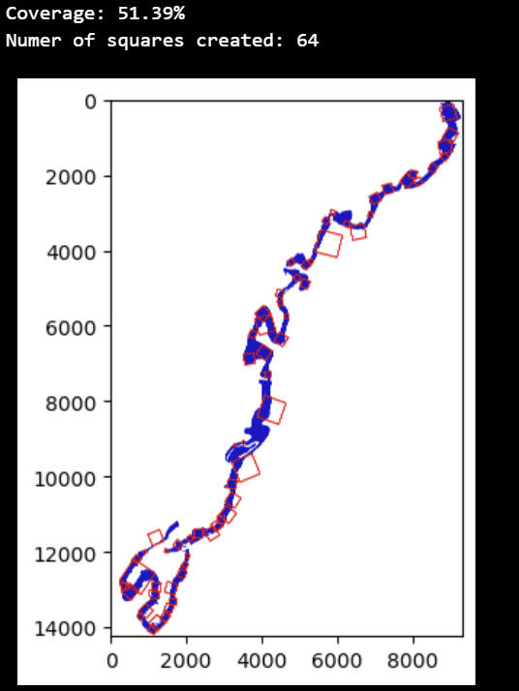
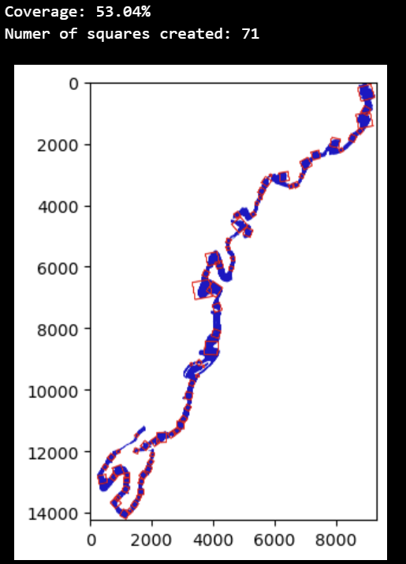
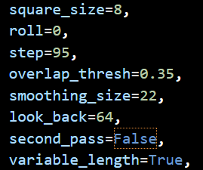
Sharon
Ryan

Slide 24
Optimal Hyperparameters
As blank pixel content and square overlap are no longer concerns:
No second pass as overlap is less of a concern and it decreases created patches
Small step size for maximum number of candidate squares
Larger look back to avoid excessive overlap without second pass
Small square size to allow patches to better fit small widths
Large smoothing size to prevent jutting normal lines
Overlap thresh of around 0.4 allows for dense square placement without excessive overlap

Slide 25
Potential Alternate Square Creation Method
Create a new square once an overlap condition is met:
Removes the need for step, look_back, and first/second passes
Works by taking a point of the contour and finding width
If square meets the overlap condition it is kept, otherwise next point is evaluated
Slower than dense approach
Fewer hyperparameters to tune
More consistent results
Addition of roll hyperparameter
Controls the first point passed into square creation while maintaining order
[1,2,3,4] -> [3,4,1,2]
This allows for differing results with fewer parameter interactions

Slide 26
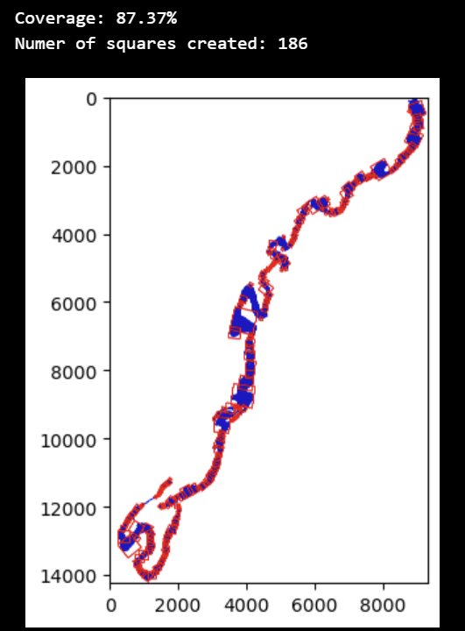
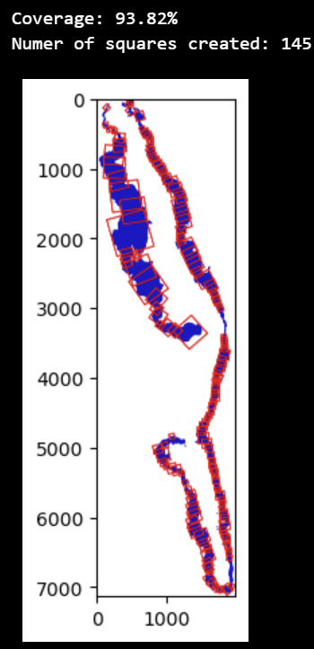
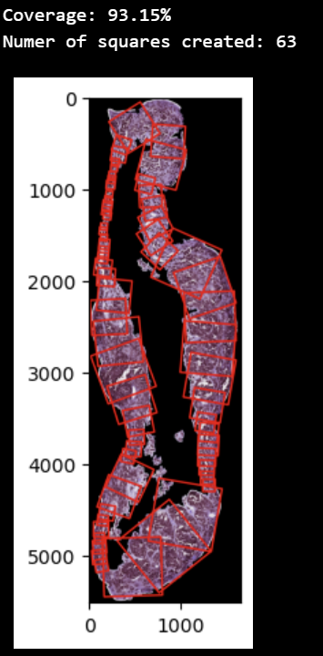
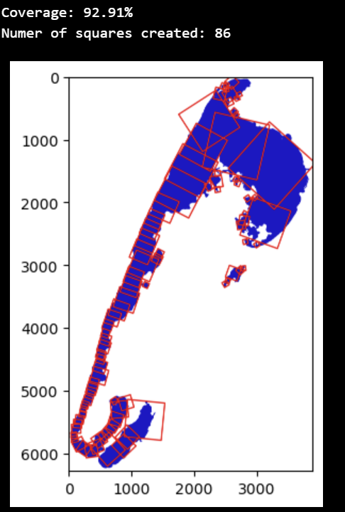

Slide 27
Observations
Mal-aligned normals are a consistent issue
Sharon’s code creates small isolated squares
Ryan’s code may do the same or create very large squares
Previously mentioned centroid adaptation may also be used to help alleviate
Using a calculated epithelium width may also help
Potentially enact these changes and then recompare approaches
Both are small variations in one segment of the entire algorithm
Simple to alternate between the two
GitHub Link

Slide 28
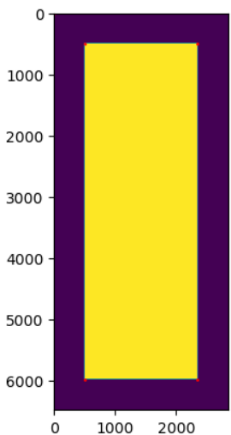
Addressing Contour within Contour bug
Test last week’s contour retrieval logic on correctly extracted QuPath annotations
This revealed that cv2.findContours treats white as foreground and black as background, so the contour logic returned only the image boundary
⇒ updated Ryan’s image preprocessing code to work with QuPath annotations
Notebook

Slide 29
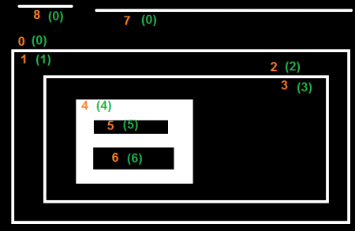
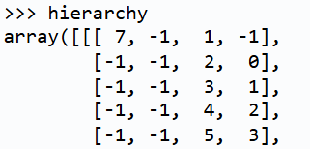
Recap: Attempt to Manipulate Contour Hierarchy
Take advantage of CV2’s built-in capabilities for tracking nested contours
[Next, prev, child, parent]
We want
Donuts (no siblings, single child)
Islands (no parent, no child)

Slide 30
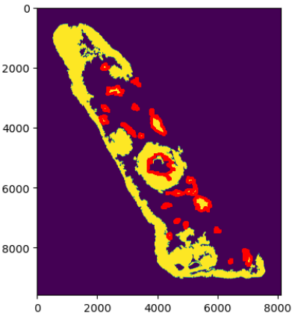
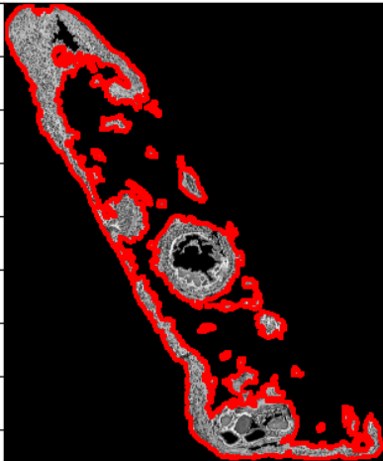
Addressing Contour within Contour bug (cont.)
2. Revised hierarchy logic
For donuts: contours were failing due to the presence of multiple nested contours within the outer border of the epithelium
The fix: check for donuts who have children but no parent, which ensures that the kept contour is the largest of any nested contours
Notebook

Slide 31
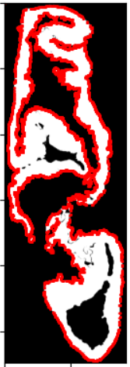
New bugs
Some slices are taking really long to generate patches with the new contours (upwards of 100 minutes)
Determine cause of disconnected contours
Thoroughly evaluate against RETR_EXTERNAL
Notebook

